Slide 1
Ensuring Sustainability for Safety and Quality Improvement Efforts
Mohamad Fakih, MD, MPH
Sarah Krein, RN, PhD

Slide 2
So we often have an effort started…
We establish a process to improve care
We figure out improvements to the process
We achieve our goals with implementation
Then what? We move to another project
How can we make sure that our gains are not lost?

Slide 3
What is Sustainability?
(Shediac-Rizkallah, Health Educ Res 1998; 13: 87-108)
Desired health benefits are maintained or improved
The innovation loses its separate identity and becomes part of regular activities (institutionalization)
Hospital staff provide ongoing support and expertise (building capacity)
Notes:
How we view it: “ability to maintain or augment the improvements gained with implementation after the program ends”
Hospital staff provide ongoing support and expertise (r/t CAUTI prevention, catheter use and safety culture)

Slide 4
When do we Start Discussing Sustainability?
Early in program implementation, with improvements seen
The program is for a limited period of time and plans for support are needed after completion of the program
Avoid having sustainability as a “latent goal” (Shediac-Rizkallah, Health Educ Res 1998; 13: 87-108)
Need to plan for sustainability

Slide 5
Planning for Sustainability
Identify required resources post-implementation
Identify mechanisms for integration of the process into daily work flow
Identify the team that will be accountable for sustaining the work (who/how)
Notes:
E.g., who is responsible for collecting and reviewing data, how will the information be used or acted upon as needed, what is the process for ongoing improvement

Slide 6
Plan for Resources
(Done During Implementation)
Engage teams and evaluate their needs: work on most efficient and effective process that is durable
Engage leaders to support sustainability: e.g., technical support (EMR), FTE support, promote collaboration to build capacity- business case is present with the improvements seen with implementation
Leaders may help with freeing FTEs or with obtaining commitment from other services to support

Slide 7
Planning for Sustainability
Identify mechanisms for integration of the process into daily work flow: achieved during implementation-institutionalization of the work
Identify the team that will be accountable for sustaining the work (who/how): if I want to know how the work is going, who is in charge? How ensuring improvements will be done?
Notes:
E.g., who is responsible for collecting and reviewing data, how will the information be used or acted upon as needed, what is the process for ongoing improvement

Slide 8
Factors that Influence Sustainability
Effectiveness
Institutionalization (routinization and integration with existing programs/services)
Building capacity: (program champions/leadership)
Context (internal and external environment)

Slide 9
1. Effectiveness
Process should be effective and perceived to be by healthcare workers (accepted)
The program fits with the organization and flexible enough to allow future modifications (Wiltsey, Implement Sci 2012; 7:17)
Periodic monitoring/evaluation and feedback
Expanding the effort by also focusing on other areas

Slide 10
The Example of the Physician-Independent Nurse Driven Urinary Catheter Discontinuation
IT and quality work on a process to evaluate UC need with the help of EHR triggers
Protocol is established, reviewed and approved by medical executive committees
Chiefs of departments notified, but information is not relayed to all urologists
The program is started. Event: a urinary catheter is removed although it was placed by a urologist for an appropriate indication

Slide 11
The Example of the Physician-Independent Nurse Driven Urinary Catheter Discontinuation
Damage control: the process is halted till more refinements
Make sure key stakeholders are involved to provide guidance/ support, and improve the chances to have successful results
Make sure that adapting the program to the organization’s needs does not result in a significant erosion of the program fidelity

Slide 12
Periodic Evaluation and Feedback
Periodic evaluation to monitor device use and event rates and to identify new or ongoing gaps for intervention
  point prevalence: e.g., central line, urinary catheter, ventilator use, pressure ulcer evaluation: a snap shot of use over time, highlights the importance of keeping event prevention a priority
  event rates: reflect outcomes (harms): helps evaluate results of your effort (CAUTI, CLABSI, VAP, falls…)

Slide 13
Periodic Evaluation and Feedback
Proper insertion technique audits: central line insertion checklist, audits for urinary catheter placement
Maintenance audits: line care (scrub the hub), dressing intactness, duration of use

Slide 14
Feedback on Performance to Teams
Discuss areas where gaps exist
Process: device use (where do they stand), appropriateness of use (reduce exposure risk)
Events: pressure ulcers, device infections, and the avoidable nature
Other events captured: eg, hematuria (UC), DVT (with CVC)

Slide 15
Opportunities for Further Improvement
Expand and spread effort activities to other units
Examples: urinary catheter, central line, peripheral venous catheter

Slide 16
Multidisciplinary and Multi-departmental
Efforts
Non-ICU
Evaluate need on admission
Evaluate for continued need
PACU/OR
ICU
ED
Remove promptly after surgery before transfer out
Evaluate for continued need
Avoid initial placement
Reevaluate for continued need after patient stabilizes
Discontinue no longer needed before transfer out
Example of the Urinary Catheter

Slide 17
Tale of the Peripheral Venous Catheter
Infection Prevention noted a cluster of cases with peripheral septic thrombophlebitis
Evaluated the process of insertion
Multiple gaps found
Multidisciplinary effort (nursing, and infection prevention) to educate and give feedback on performance to staff
Worked with all units, with a gradual implementation

Slide 18
Tale of the Peripheral Venous Catheter
Significant improvements in process and outcome, and sustained
Key was continued audits and direct feedback to the bedside nurse
If a PVC was >96 hours, dressing was not intact, or any complications: direct discussion with the bedside nurse
Monthly reports to the units on their performance

Slide 19
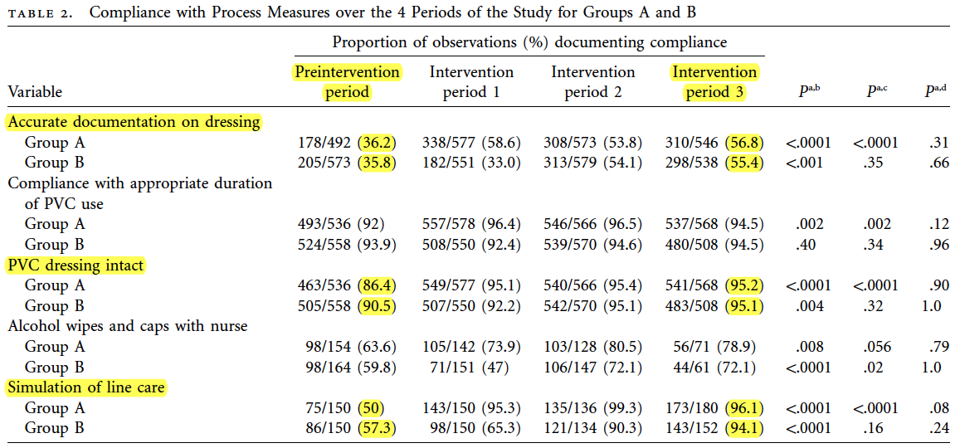
Tale of the Peripheral Venous Catheter (Fakih, Infect Control Hosp Epidemiol 2012;33(5):449-55)

Slide 20
Tale of the Peripheral Venous Catheter
Infection related to the PVC dropped and we found out that the majority of the infections are for PVCs originating from the Emergency Department
Multidepartmental effort (ED, nursing, infection prevention) to improve the PVC placement and care in the ED
Education and feedback resulted in sustained improvements
Collaborative led to further reduction in PVC infection in the hospital!

Slide 21
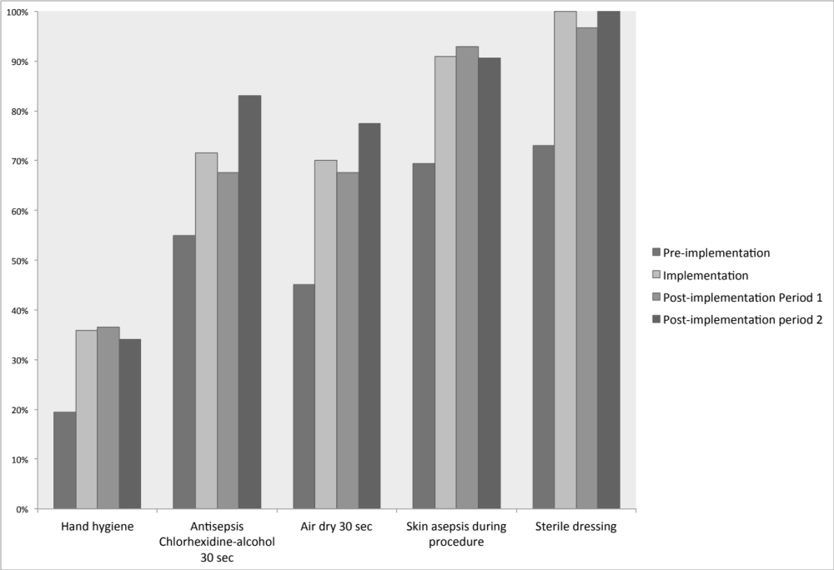
Tale of the Peripheral Venous Catheter
(Fakih, Am J Infect Control 2013; 41(6): 531-6)

Slide 22
2. Institutionalization
The program becomes a part of the standard of care in the hospital (only place the catheter based on appropriate indication, comply with proper insertion and maintenance, daily evaluation for need and removal when no longer needed)
With time, modifications of the program may occur based on new evidence
Notes:
The innovation (CAUTI prevention/reducing catheter use) loses its separate identity and becomes part of regular activities (institutionalization)

Slide 23
Institutionalization
(Routinization and Integration)
  Alignment with the organization’s goals (e.g., promoting safety, process and outcome dashboards
  Policies and SOPs: update policies based on best practices, and share with healthcare workers
  Regular education and competencies: e.g., line and UC placement and management helps keep healthcare workers updated on the best practices
Notes:
If the program is aligned to the organization’s goals, leadership support will be more feasible
Promoted as aligned with the organization’s goals (e.g., promoting safety)
Integration into policies and Standard Operating Procedures (SOPs)
Regular education and competencies
Evaluation urinary catheter need is part of daily nursing routine
Use of EMR/electronic reminders or tools to support

Slide 24
Institutionalization
(Routinization and Integration)
  Healthcare worker daily routine: incorporate it into the workflow (imagine taking vitals, do we forget?)
  Use of electronic medical records: incorporate into order sets, and build reminders or triggers. Needs to be operator friendly, avoid alert fatigue
  Identify how this work might be synergistic with other initiatives: multiple tasks may be bundled together to ensure efficiency and compliance
Notes:
If the program is aligned to the organization’s goals, leadership support will be more feasible
Promoted as aligned with the organization’s goals (e.g., promoting safety)
Integration into policies and Standard Operating Procedures (SOPs)
Regular education and competencies
Evaluation urinary catheter need is part of daily nursing routine
Use of EMR/electronic reminders or tools to support

Slide 25
3. Building Capacity
Continued funding (difficult to keep)
Collaboration between different stakeholders in the organization (significant support)
Workforce turnover (negative effect)

Slide 26
Could this happen at your hospital? The Story of Mr. Smith (1)
Mr. Smith is 82 year old and gets admitted because of mild congestive heart failure. In the Emergency Department, a urinary catheter is placed (although he can use the urinal), and he is transferred to the floor but could not sleep. He is prescribed a sleeping pill. He gets more restless, gets out of bed, trips on the catheter and falls. He is found to have a left hip fracture, and undergoes surgery. Post-operatively, the staff notes that his left leg is swollen and he is diagnosed with deep venous thrombosis. He is started on blood thinners.

Slide 27
Could this happen at your hospital? The Story of Mr. Smith (2)
Because of his immobility, he develops a pressure ulcer on his sacrum. His physician removes the catheter, but now he is having urinary retention related to pain medications. The urinary catheter is placed again. The procedure results in hematuria with the difficulty in insertion and being on blood thinners. Few days later, he develops fever and his blood pressure drops. Blood cultures and urine cultures grow Escherichia coli and he is diagnosed with CAUTI and septicemia. After 6 weeks in the hospital and many complications, Mr. Smith is no longer the same.

Slide 28
Partnership for patients
Patient: Urinary Catheter Harm
CAUTI
Increased Length of Stay
Patient discomfort
Trauma
Pressure ulcers
Immobility
Venous thrombo-embolism
Falls
Adverse drug events
Different harms are connected: Multiple stakeholders need to work together

Slide 29
The Champions (Physicians/Nurses)
Identified during program implementation
Keep the effort as a priority during sustainability
Provide expertise in the topic
Liaison with peers to promote best practice

Slide 30
Context
(Internal and External Environment)
Internal environment: organization geared towards quality and safety, leaders adopting best practices, employee satisfaction and morale
External environment:
Public reporting and value based purchasing
National efforts: “Partnership for Patients”, SCIP
Incentives of 3rd party payers
State efforts
Notes:
Public reporting: CAUTI from ICU started Jan 2012, inpatient rehabilitation October 2012, long term care hospitals October 2012.
Partnership for patients: HEN supports it

Slide 31
Example of Successful Sustainability: SJHMC
Pilot for nurse driven multidisciplinary rounds to assess urinary catheter need
Educated nurses on risks of the catheter and appropriate indications
Updated hospital policies for urinary catheter placement and maintenance
Involved all stakeholders: nurses, physicians, midlevel providers, ancillary services
Involved multiple departments: non-ICU, ED, and ICU

Slide 32
Example of Successful Sustainability: SJHMC
Incorporated daily assessment of the urinary catheter as part of the nurses daily work.
Operationalized the evaluation of need by having twice weekly urinary catheter use fed back from non-ICU to Infection Prevention
Linked the work to safety efforts: SCIP, pressure ulcers, and immobility/ falls.

Slide 33
Does the Effect Persist?
(Fakih, Am J Infect Control 2013; 41:236-239)
Nurse-driven removal of unnecessary catheters
Incorporating the evaluation of catheter need during nursing rounds, and collecting urinary catheter prevalence twice weekly since 2007
Establishing institutional guidelines for the ED and education
Urinary Catheter Prevalence (%)
SJHMC, Detroit, MI
Notes:
Must all good things come to an end? How do we sustain low urinary catheter prevalence permanently? Nurses must incorporate urinary catheter evaluations into their daily assessments. Data collection and feedback help sustaining the improvement. At St. John Hospital & Medical Center, urinary catheter use data continue to be collected biweekly, thanks to a collaborative effort among Infection Prevention, Quality and Case Management teams. Prevalence results are periodically fed back to the units.

Slide 34
How Do We Sustain Safety Efforts?
By demonstrating continuing effectiveness of program and identifying other opportunities for additional improvement
Institutionalization/ routinization/ integration of efforts
Building capacity and supporting internal champions
Identifying ways to synergize or leverage the work in alignment with other external initiatives or pressures

